Slide 1
COMMISSIONER CABINET
Monthly Training

Slide 2
Jack Boyde
Assistant Council Commissioner
Health & Safety
Prepared… for anything

Slide 3
H&S: Prepared for Anything
Notes:
INTRO:
The safety of our youth, volunteers, staff, and employees cannot be compromised. Health and safety must be integrated into everything we do to the point that no injuries are acceptable beyond those that are readily treatable by Scout-rendered first aid.

Slide 4
H&S: Prepared for Anything
Everyone Must Work Together:
Know, understand, and comply with all rules, policies, and procedures
Model safe behaviors
Encourage volunteer leaders and youth members to share in the management of risk
Promote, provide, and, when appropriate, require health and safety training

Slide 5
H&S: Prepared for Anything
Question:
What is “official” the Commissioner Role in Health & Safety?
Answer:
Nothing!
Notes:
There is nothing in the Commissioner “official” literature that requires the Commissioner to do anything with H&S

Slide 6
H&S: Prepared for Anything
Why:
So why this training topic?
Commissioners are skilled and knowledgable. They can…
Provide an audit function
Give good advice or suggestions
Update leaders on current resources/rules
Notes:
HOWEVER!

Slide 7
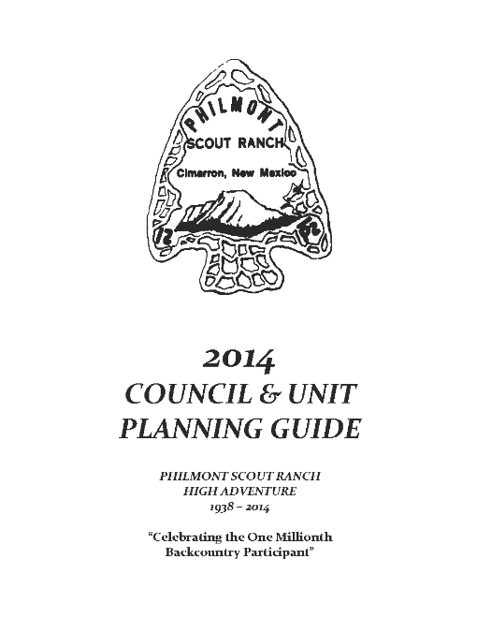
H&S: Prepared for Anything
Example #1:
A Boy Scout troop is thinking about going to a high adventure base. What advice could the UC give them?
Notes:
As of 2014, at least TWO people per Crew must be trained in Wilderness First Aid plus adult AED/CPR for Northern Tier, Philmont and Sea Base (The Summit only requires ONE person). Knowing this far enough in advance will prevent disappointment!
Source: Council & Crew Planning Guides (unique to each HA base)

Slide 8
H&S: Prepared for Anything
Example #2:
A Cub Pack wants to go on an overnighter. What are the two key requirements they should consider?
Notes:
Are they going to a Council-approved location?
Has at least one adult giving leadership to the overnighter taken BALOO training?
SOURCE: #510-631 Cub Scout Outdoor Program Guidelines

Slide 9
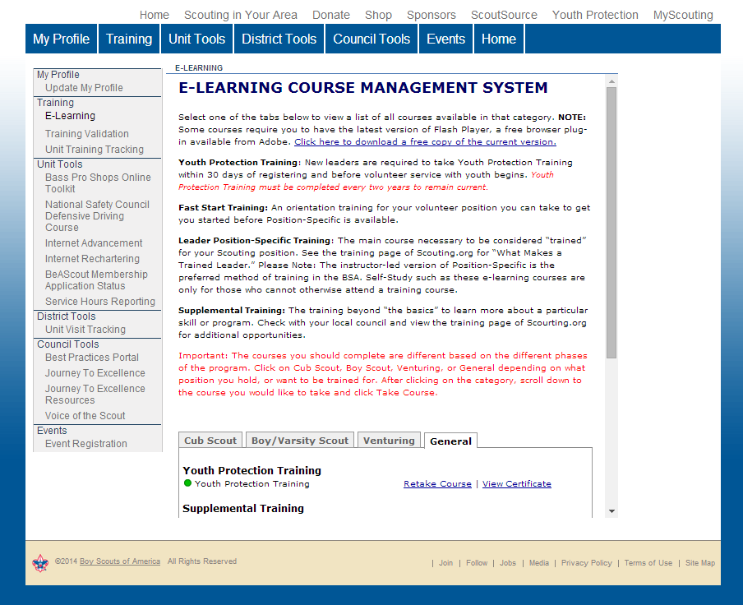
H&S: Prepared for Anything
Standard Practice
Remind Leaders to stay up-to-date with online safety training.
Notes:
Health & Safety training is valid for two years.

Slide 10
H&S: Prepared for Anything
Examples of Required Training:
Youth Protection Training: all outings
Planning & Preparing for Hazardous Weather: all outings
Safe Swim Defense: aquatic/swim activities
Safety Afloat: boating activities
Climb On Safely: climbing activities
CPR: climbing & boating activities
Wilderness First Aid: backcountry tours
Notes:
PLUS… CPR/AED for Back Country tours
WFA (and above) plus CPR/AED requirements depend upon the event or activity planned… frequently determined by the proximity of emergency medical personnel and emergency facilities.

Slide 11
H&S: Prepared for Anything
ALSO these training courses!
NRA Instruction and Range Safety Officer: all shooting activities
Paddlecraft Safety
Swimming & Water Rescue
Any others?
Notes:
NRA instruction must be specific to the shooting being conducted…
Aquatics - not online courses. Good for 3 (three) years.
Note: BSA Lifeguard training – now conducted for Camp Staff
Aquatics Supervision courses of Swimming and Water Rescue and Aquatics Supervision: Paddle Craft Safety cover SKILLS needed to meet Safe Swim Defense and Safety Afloat policies applied at the unit level.
Additional experience and training required for SCUBA, whitewater, tow sports, etc.
ASK any other safety training to consider??

Slide 12
H&S: Prepared for Anything
Have you ever used this pledge?
I will not drive when I feel fatigued. I realize that when I am fatigued, I process information more slowly and less accurately and this impairs my ability to react in time to avoid accidents.
I will arrange my schedule so that several days before a Boy Scout "driving trip," I will get a good night's sleep every night to avoid the cumulative effect of not getting enough sleep.
I will make trip preparations far enough in advance so that last-minute preparations don't interfere with my rest.
I will make travel plans that take into account my personal biological clock and only drive during the part of the day when I know I will be alert.
I will be smart about engaging in physical activities during Scouting outings and will make sure that I will be ready to drive alertly.
Notes:
Not a bad idea to review this with the unit committee every year!
SAFE DRIVER PLEDGE

Slide 13
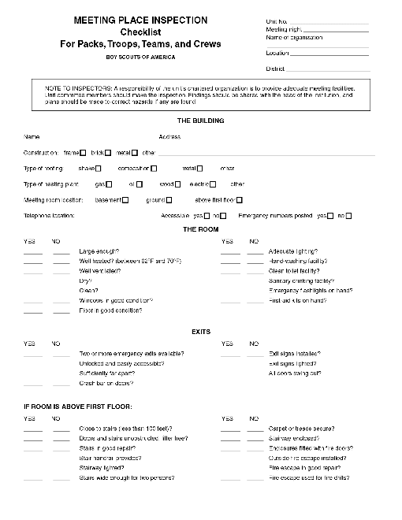
H&S: Prepared for Anything
Have you considered…
Doing a meeting place inspection?
USE the BSA Meeting Place Inspection Checklist
Notes:
Share the results with the Charter Organization (and Service Executive)
SOURCE: #34416 Guide to Safe Scouting

Slide 14
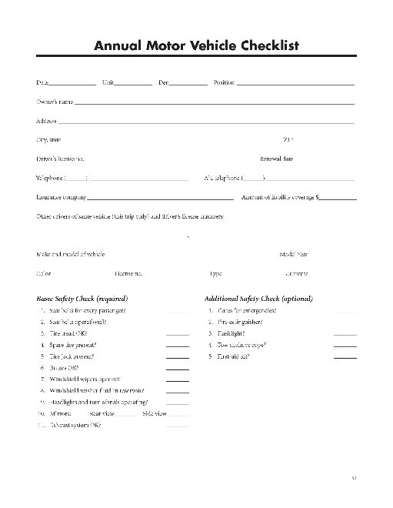
H&S: Prepared for Anything
Do your units know about…
Annual Motor Vehicle Checklist
USE the BSA form
Notes:
Provides an “extra” opportunity to make Scouting safe for our youth
Allows the “suggestion” to include flares, flashlight, first aid kit, etc.
Lets adult leaders/volunteer drivers know we are serious about safe driving!
SOURCE: #34416 Guide to Safe Scouting

Slide 15
H&S: Prepared for Anything
New!:
Pocket version of GSS (Guide to Safe Scouting)
Notes:
Makes it easier to fulfill the Tour Permit requirement… where Committee Chair and Adult leader SIGN and say that “adult leaders have read and are in possession of a current copy of Guide to Safe Scouting”

Slide 16
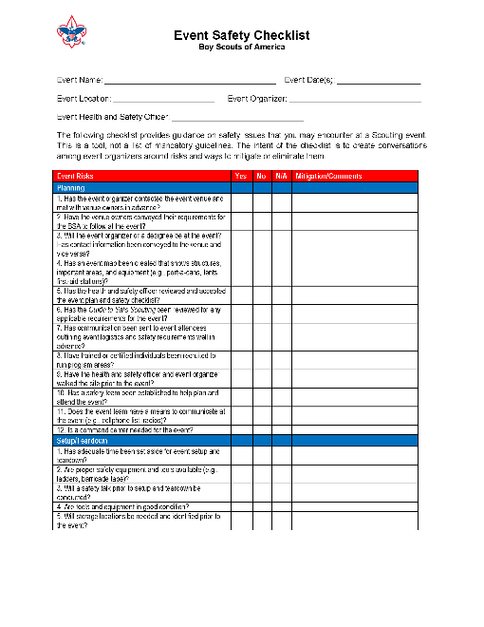
H&S: Prepared for Anything
New!:
Event Checklist
Notes:
SOURCE: #34416 Guide to Safe Scouting
The checklist provides guidance on safety issues that a unit may encounter at a Scouting event.
It is a tool, not a list of mandatory guidelines.
The intent is to create conversations among event organizers around risks and ways to mitigate or eliminate them.

Slide 17
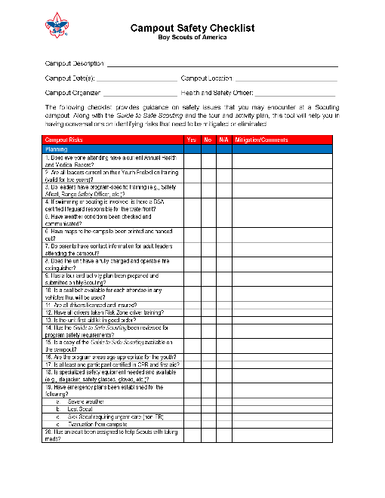
H&S: Prepared for Anything
New!:
Campout Checklist
Notes:
SOURCE: #34416 Guide to Safe Scouting
Similar purpose as the Event Checklist – with specific items to consider for a Scouting Campout.

Slide 18
H&S: Prepared for Anything
Tools:
LHC Commissioner website: http://commissioner-bsa.org/h&s

Slide 19
Questions?

Slide 20
Notes:
Thank You

